Slide 1
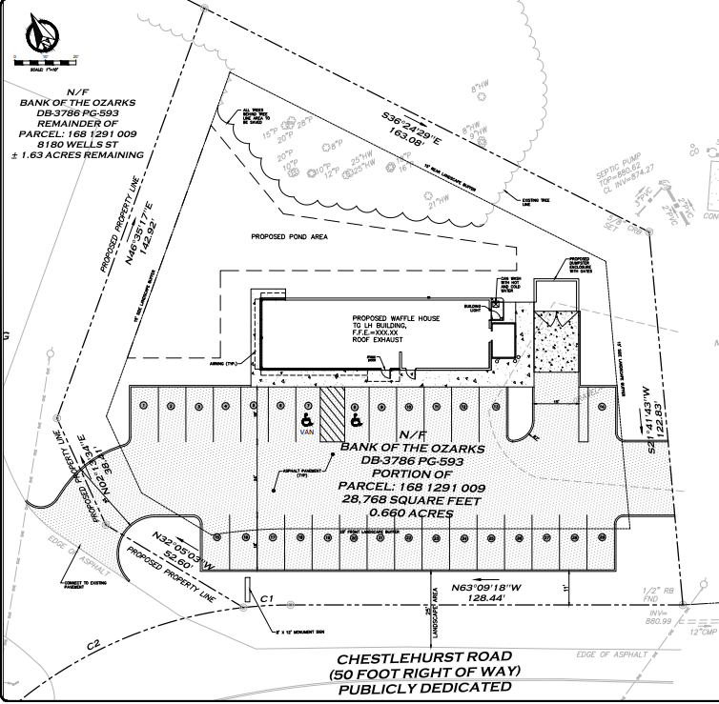
Waffle House Plat

Slide 2
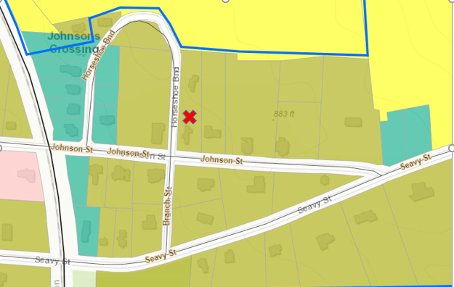
Current Zoning Map

Slide 3
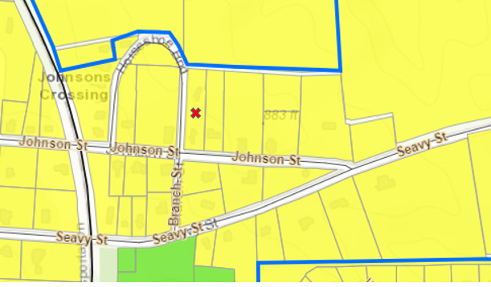
Future Land Use Map

