Slide 1

FEBRUARY 5, 2024
MEETING OF SENOIA
MAYOR AND COUNCIL

Slide 2
CITY OF SENOIA
MEETING OF MAYOR AND COUNCIL
FEBRUARY 5, 2024
1. CALL TO ORDER / WELCOME VISITORS
Pledge of Allegiance
Open Meeting Declaration
2. Approval of February 5, 2024 city council agenda
3. APPROVAL OF DECEMBER 18, 2023, CITY COUNCIL MEETING MINUTES
4. CLAIMS AGAINST THE CITY

Slide 3
CITY OF SENOIA
MEETING OF MAYOR AND COUNCIL
FEBRUARY 5, 2024
5. NEW BUSINESS
A) Ordinance No. 24-01 1st Read Commercial Corridor (HWY 85/HWY 16) Overlay Text Amendments.
B) 100 Traditions Way – Pool Variance
C) 279 Pylant Street – Accessory Structure Variance
D) Senoia Gateway - Variances to Commercial Corridor
(HWY 85/HWY 16) Standards

Slide 4
ORDINANCE 24-01
he following are Commissioners on the Hist1, 2022
AN ORDINANCE TO AMEND THE COMMERCIAL CORRIDOR (HWY85/HWY16) OVERLAY STANDARDS AS IT RELATES TO GOLF CART PARKING CALCULATIONS AND THE USE OF STANDARD CONCRETE FOR SIDEWALKS BOTH ALONG PUBLIC ROADS AND INTERNAL TO A SITE.

Slide 5
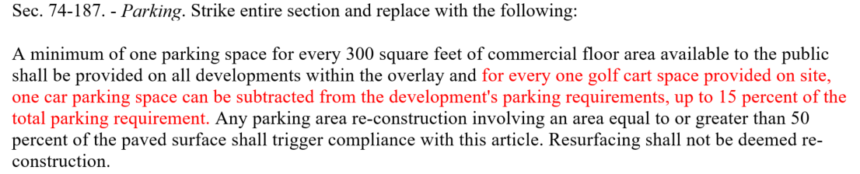
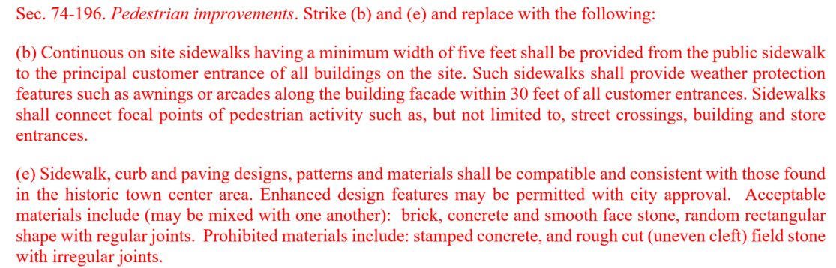

Slide 6
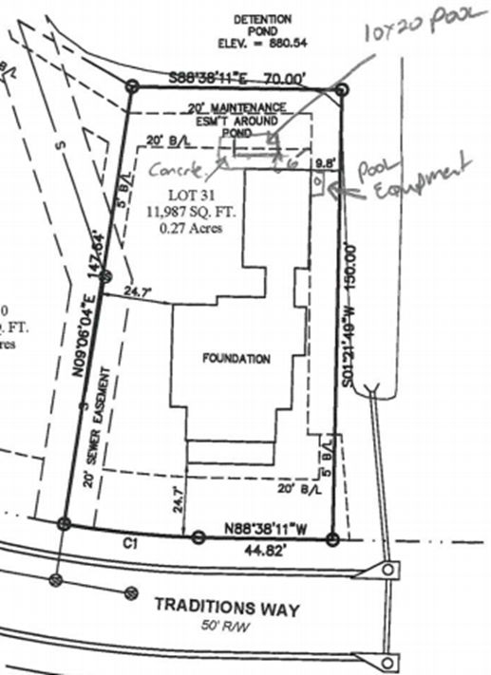
100 Traditions Way – Pool Variance

Slide 7
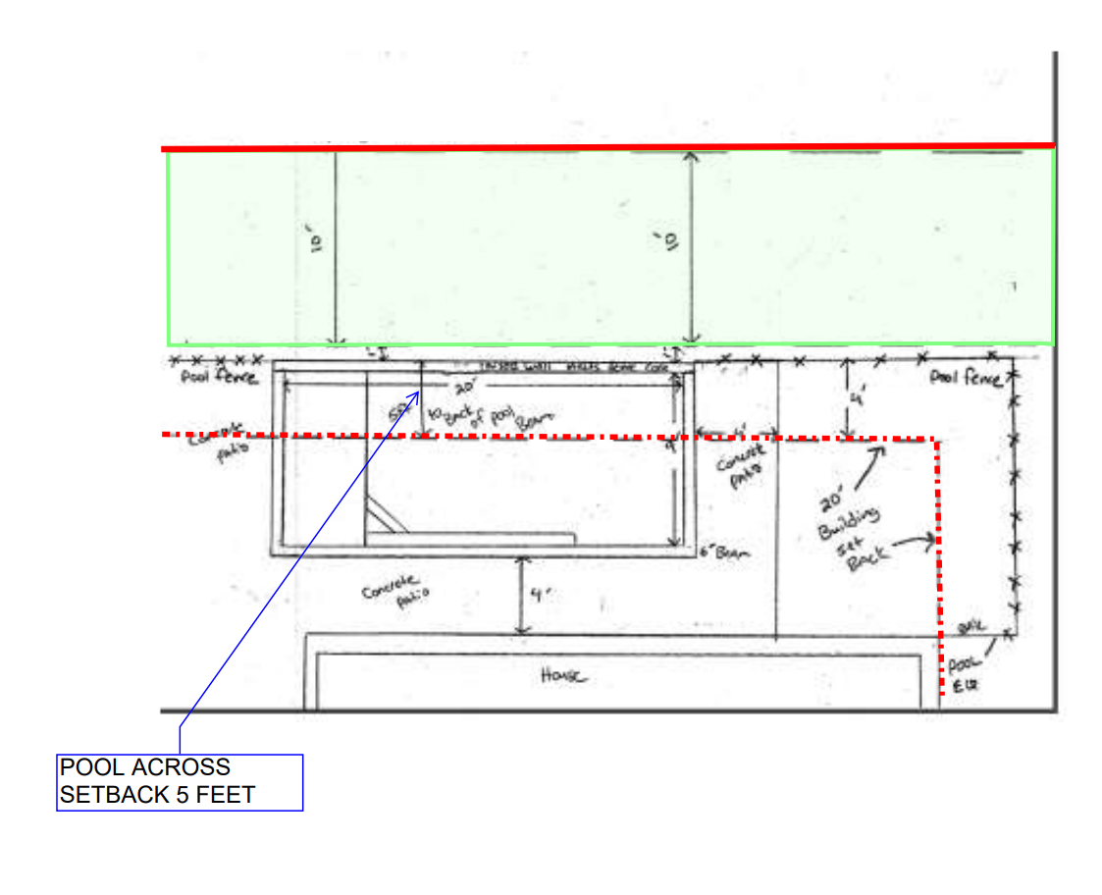
No negative impacts to adjacent properties are expected as a result of approving the variance for the pool to be located 5 feet within the rear setback.

Slide 8
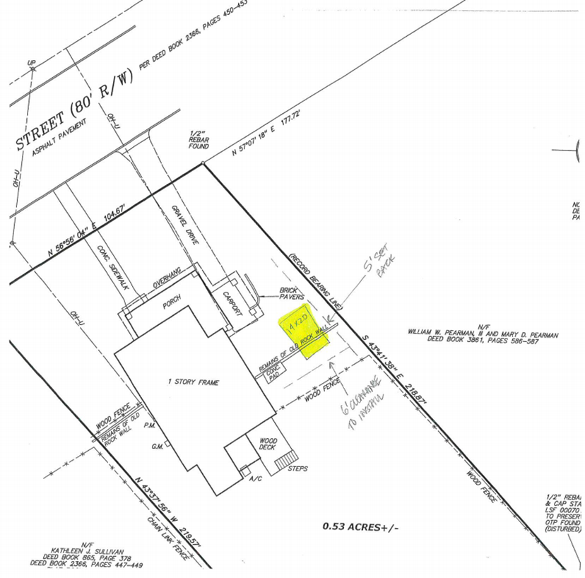
279 Pylant Street – Accessory Structure Location Variance
Sec. 74-265 (3)
“An Accessory structure shall not be permitted in a front or side yard in the residential districts.”
Sec. 74-265 (14)
“All accessory structures, including detached garages, located a distance equal to or less than the dimension of the required side yard for the zoning district in which the lot is situated, shall be screened through the installation or stockade type fence. Such screening shall be in compliance with provisions of section XII, buffer area of the zoning ordinance.”

Slide 9
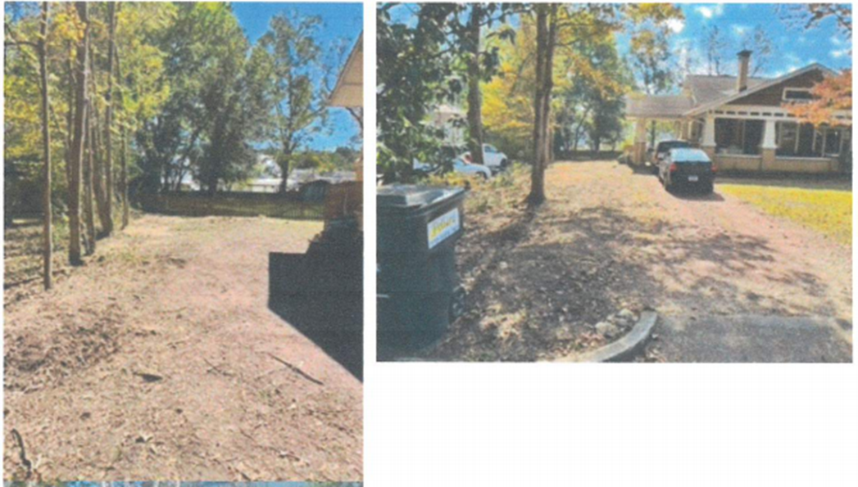
No negative impacts to adjacent properties are expected as a result of approving the variance.
Mitigation in the form of a privacy fence should be required if variance is approved.

Slide 10
Senoia Gateway - Variances
Variance #1
Applicant is seeking relief from section 74-186 (c) and (d) to allow internal street widths including curb and gutter to exceed 24 feet.
Justification – to support truck routes internal to the site to avoid any backup or congestion onto the state highways.
Lane widths proposed at 14 feet with standard curb and gutter (24-inch)
Total width of proposed road including curb and gutter is 32 feet.
Total width allowed by overlay is 24 feet.
This request is consistent with internal road widths at the Publix shopping center. If approved, no negative impacts to adjacent properties are anticipated.

Slide 11
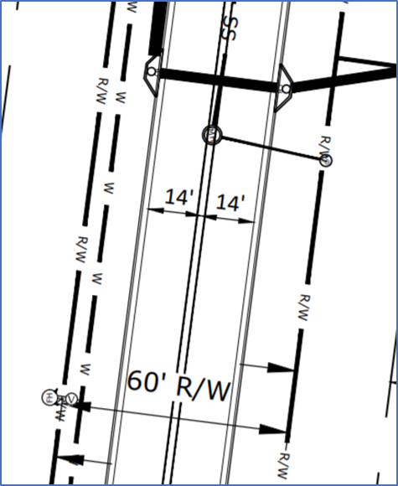
Senoia Gateway - Variances

Slide 12
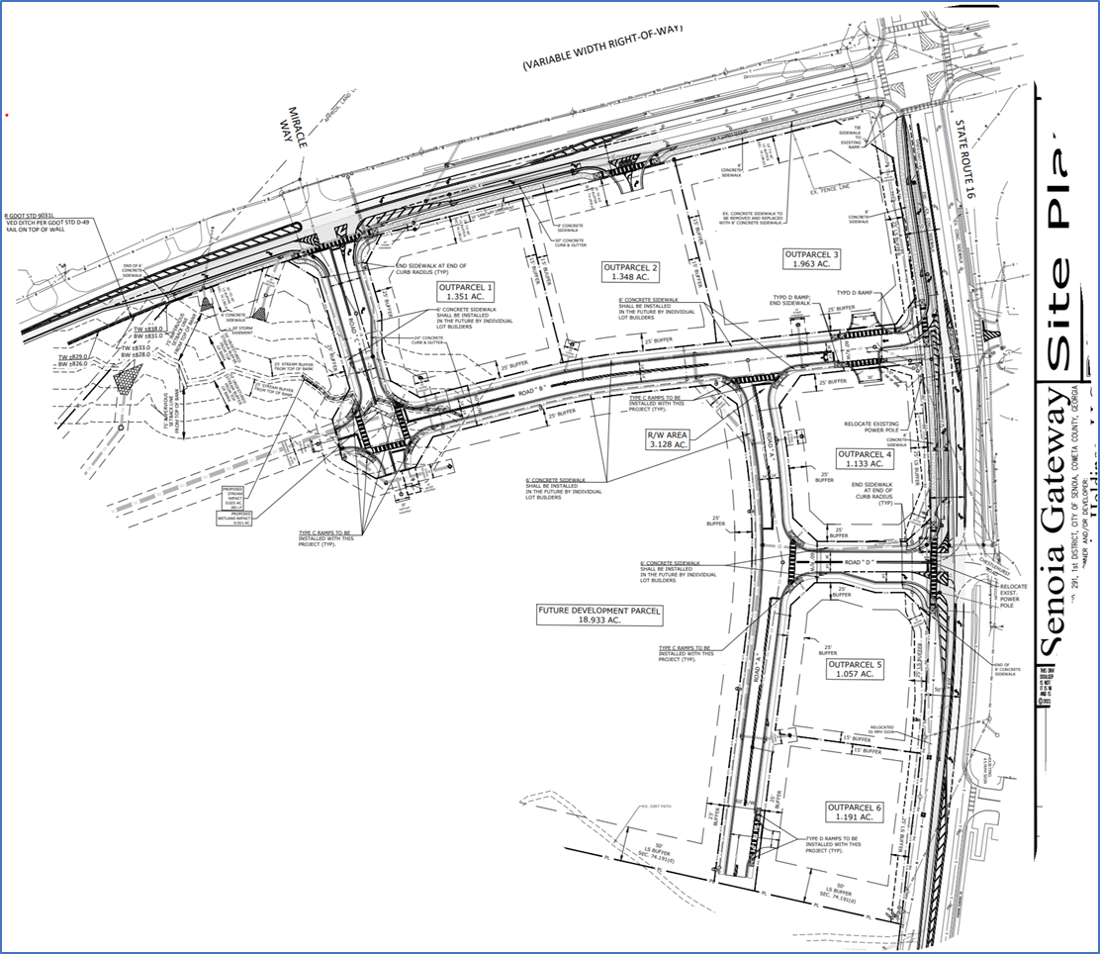

Slide 13
Senoia Gateway - Variances
Variance #2 – if text amendment for concrete is not approved
Applicant is seeking relief from section 74-196 (e) to allow for standard concrete sidewalks versus pavers, bricks or scoured concrete as currently required by the overlay.
The use of traditional concrete sidewalk is consistent with the surrounding developments in the overlay district.
Additionally, concrete sidewalk has significantly lower maintenance needs than bricks and pavers especially when in close proximity to trees roots.
Vehicular surfaces will be asphalt paved and pedestrian paths marked with crosswalks which is easily distinguished from concrete sidewalks.
This request is consistent with internal road widths at the Publix shopping center. If approved, no negative impacts to adjacent properties are anticipated.

Slide 14
6. ANNOUNCEMENTS
7. ADJOURN

Slide 15
APPEARANCES FROM THE FLOOR
Citizen comments should relate to specific agenda items, not listed on the agenda for a Public Hearing, or to a concern within the jurisdiction of the City. Council meetings serve the purpose of conducting city business and are not a forum for the unlimited expression of opinion. If an item is listed on the agenda for a Public Hearing, you will have an opportunity at that time to comment on the particular matter. All comments should be limited to three (3) minutes. The Mayor reserves the right to limit comments to matters germane to city business and may refer speakers to the City Administrator or other staff for resolution. Comments shall be addressed to the Council as a whole and not to individual councilmen or staff. The Mayor shall maintain decorum and unruly behavior will not be tolerated.

